Slide 1
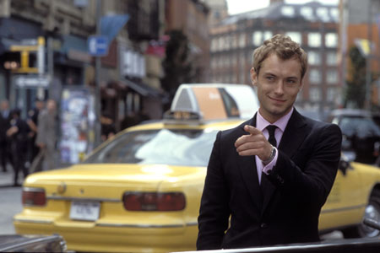
«Personally, I’ve always suspected that everyone else is having a far merrier Christmas than I am.»
Bilde: United International Pictures
Alfie, i filmen Alfie

